Slide 1
Lecture 9
DTMC – Limiting Behavior Examples

Slide 2
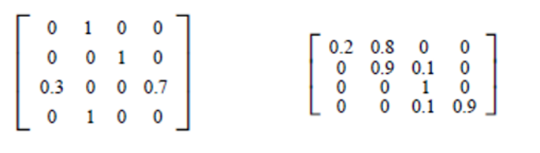
Example 1
Classify states of the following DTMC

Slide 3
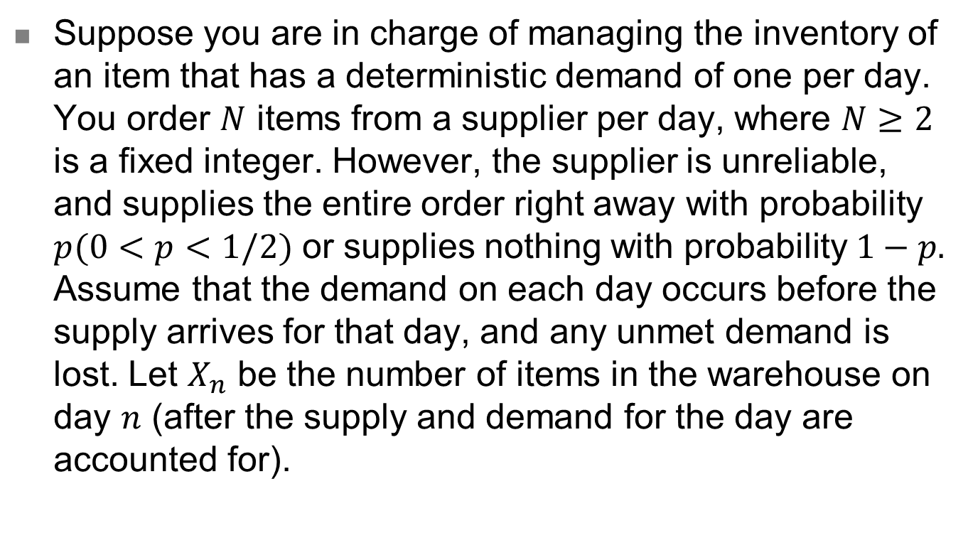
Example 2
Suppose you are in charge of managing the inventory of an item that has a deterministic demand of one per day. You order $N$ items from a supplier per day, where $N≥2$ is a fixed integer. However, the supplier is unreliable, and supplies the entire order right away with probability $p(0<p<1/2)$ or supplies nothing with probability $1−p.$ Assume that the demand on each day occurs before the supply arrives for that day, and any unmet demand is lost. Let $X_{n}$ be the number of items in the warehouse on day $n$ (after the supply and demand for the day are accounted for).

Slide 4
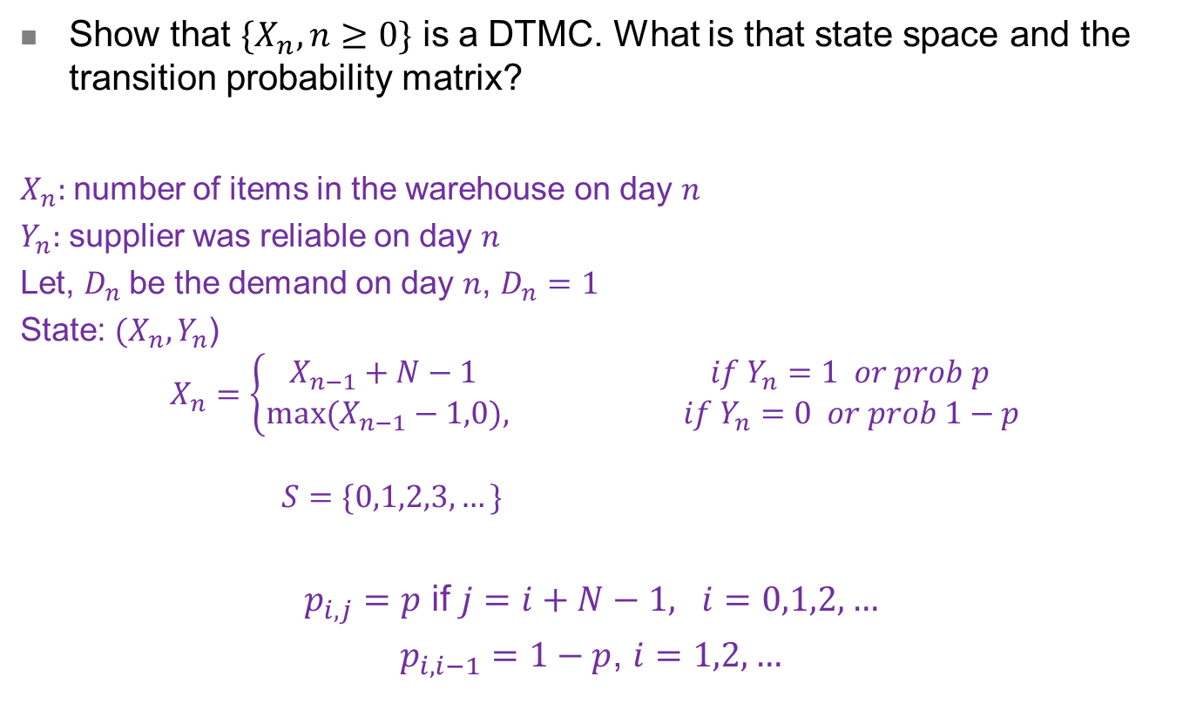
Example 2 – Question 1
Show that $\{X_{n},n≥0\}$ is a DTMC. What is that state space and the transition probability matrix?
$X_{n}:$number of items in the warehouse on day $n$
$Y_{n}:$ supplier was reliable on day $n$
Let, $D_{n}$be the demand on day $n$, $D_{n}=1$
State: $(X_{n},Y_{n}$)
$$X_{n}=\left\{\begin{aligned}X_{n−1}+N−1 if Y_{n}=1 or prob p \\ {max⁡(X}_{n−1}−1,0), if Y_{n}=0 or prob 1−p\end{aligned}\right.$$
$$S=\{0,1,2,3,…\}$$
$p_{i,j}=p$ if $j=i+N−1, i=0,1,2,…$
$p_{i,i−1}=1−p$, $i=1,2,…$

Slide 5
Example 2 – Question 2
Is it irreducible and aperiodic? Why or why not?
Lets draw the transition diagram
Lets see for N=2
Clearly DTMC is irreducible with period 1
Lets see of N=3?

Slide 6

Example 2 – Question 3
For a fixed $p$, what are the possible values of $N$ that will ensure that $\{X_{n}, n≥0\}$ is a positive recurrent DTMC?
Take a guess. We are not going to prove it theoretically.

Slide 7
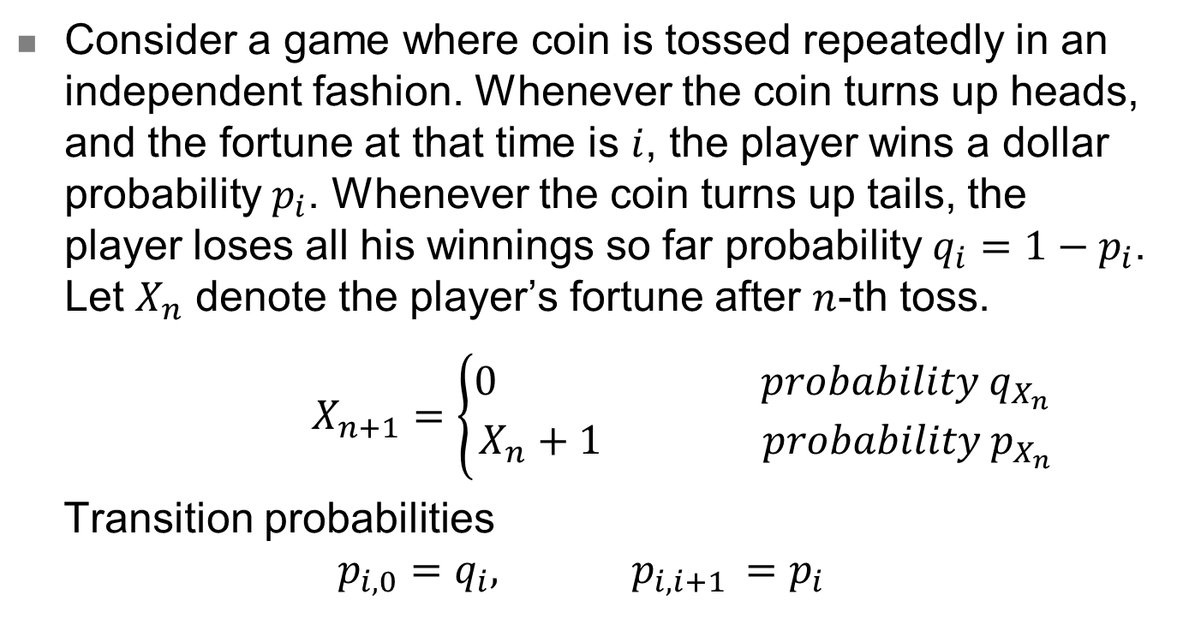
Example 3
Consider a game where coin is tossed repeatedly in an independent fashion. Whenever the coin turns up heads, and the fortune at that time is $i$, the player wins a dollar probability $p_{i}$. Whenever the coin turns up tails, the player loses all his winnings so far probability $q_{i}=1−p_{i}$. Let $X_{n}$ denote the player’s fortune after $n$-th toss.
$X_{n+1}=\left\{\begin{aligned}0 probability q_{X_{n} } \\ X_{n}+1 probability p_{X_{n}}\end{aligned}\right.$
Transition probabilities
$$p_{i,0}=q_{i}, p_{i,i+1 }=p_{i}$$

Slide 8
Example 3 – Question 1
Is the DTMC irreducible?
With close inspection of transition probabilities, Yes???

Slide 9
Example 3 – Question 2
Is the DTMC irreducible?
With close inspection of transition probabilities, Yes???

Slide 10
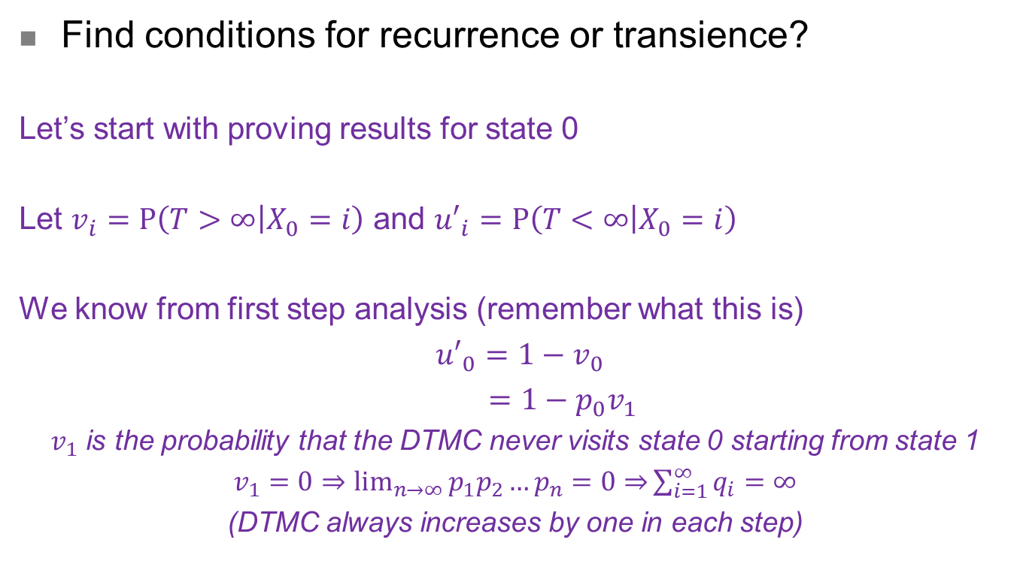
Example 3 – Question 3
Find conditions for recurrence or transience?
Let’s start with proving results for state 0
Let $v_{i}=P\left(T>∞ | X_{0}=i\right)$ and ${u′}_{i}=P\left(T<∞ | X_{0}=i\right)$
We know from first step analysis (remember what this is)
${u′}_{0}=1−v_{0}$
$=1−{p_{0}v}_{1}$
$v_{1}$ is the probability that the DTMC never visits state 0 starting from state 1
$v_{1}=0⇒\lim_{n→∞}{p_{1}p_{2}…p_{n}=0⇒}\sum_{i=1}^{∞}{q_{i}}=∞$
(DTMC always increases by one in each step)

